Slide 1



SMART INDIA HACKATHON 2026
Problem Statement ID – SIH26265
Problem Statement Title - Streamlining of Security Deposit / FDR Portal (NidhiTrack)
Theme – Smart Automation
PS Category - Software
Team ID - 197807
Team Name – TEAM-INNOVATIONS

Slide 2









NIDHITRACK – IDEA / SOLUTION
PROBLEM STATEMENT
IDEA / SOLUTION
HOW NIDHITRACK ADDRESSES IT
Paper FDRs & registers
Physical submission and manual entry cause duplicate data; files get lost or misfiled
NidhiTrack is an end-to-end digital portal that takes every security deposit / FDR from submission to verified lien, auto-monitoring, renewal and release – one workflow, one audit trail. It replaces paper files, registers and Excel sheets with one transparent system for contractors, officers, finance teams and auditors.
Paper FDR + registers
Digital + eSign
Manual bank calls
API / OCR verify
Excel reminders
Auto alerts
Missed maturity / expiry
Cover lapses before anyone notices, leaving the department without valid security
Key Features:
eSign submission of SD / EMD / FDR with DigiLocker documents
AI + OCR checks flag duplicate, tampered or expired
FDRs
Bank / e-FDR verification and digital lien marking
Auto alerts at 90 / 60 / 30 / 7 days before maturity or expiry
Rule-based refund release on contract completion, with SLA timers
Live dashboard and tamper-proof audit trail for officers and auditors
Role-based access for vendors, officers, finance and auditors, secured with 2FA
Configurable EMD / performance-security rules for each department
Bulk upload and OCR to digitise existing FDR registers
Months to refund
Rule-based release
Scattered records
Live dashboard
Fake or tampered FDRs
Hard to verify with the bank in time; forged or altered FDRs can slip through
UNIQUE VALUE PROPOSITION
One portal, full lifecycle: Manage the entire FDR process in one portal.
Slow refunds
Vendors chase offices again and again; refunds are delayed for months
Zero lapsed cover : Never miss a date-Automatic alerts ensure no FDR expires unnoticed.
Fraud-aware verification : Detect fake , duplicate, or tempered FDRs.
No single live view
Officers cannot see status or risk at a glance, so decisions are slow and reactive
Open APIs: e-procurement, PFMS, banks-Connect easily with e-procurement, PFMS, and banks

Slide 3
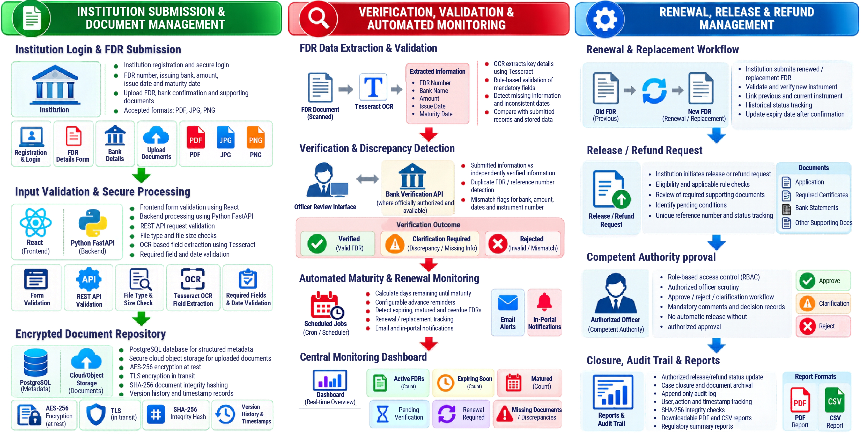







TECHNICAL APPROACH
</>Technology stack
React + Typescript Frontend Portal
Django + Python Backend & APIs
PostgreSQL FDR / Instrument Data
S3 Object Storage Secure Document Storage
OCR (Tesseract) Extract Data from Document
Keycloak / JWT Authentication & RBAC
Docker + Nginx Deployment

Slide 4







FEASIBILITY AND VIABILITY
FEASIBILITY
VIABILITY
Proven building blocks – Web portal, OCR, eSign and SMS are mature, off-the-shelf tech, so the build relies on proven components rather than new research.
Fits existing rules – EMD / performance-security norms (GFR 2017) set as configurable rules, so each department can adapt limits and validity periods.
Phased bank verification – Start with OCR + bank confirmation; move to bank APIs / e-FDR as banks onboard.
Low cost – Open-source stack (React, FastAPI, PostgreSQL) with no licence fees; cloud or on-prem hosting as the department prefers.
Scheduler-driven alerts – Nightly jobs track every maturity and expiry date and trigger alerts at 90 / 60 / 30 / 7 days by SMS, email and WhatsApp.
Modular & scalable – Per-department rules and plug-in APIs let new departments, banks and PSUs be added without redesign.
Demonstrable MVP – Core flow: submit → verify → alert → release, demonstrable end to end with sample deposits and a live dashboard.
Trust & compliance – RBAC, 2FA, encryption in transit and at rest, hash-chained audit trail, DPDP Act-aligned consent and data handling.
POTENTIAL CHALLENGES
OVERCOME METHODS
Banks may lack uniform APIs for FDR verification and lien marking; formats and response times differ from bank to bank.
Pluggable bank adapters with OCR + manual confirmation fallback; start with pilot banks and add more over time.
Sensitive financial data and risk of insider misuse or unauthorised changes to deposit records.
Role-based access, encryption, 2FA, maker-checker approvals and an immutable audit log.

Slide 5








IMPACT AND BENEFITS
CONTRACTORS & VENDORS
OFFICERS & FINANCE
GOVT & AUDITORS
Submit online, track live and get refunds on time – no repeated office visits or lost FDRs. eSign, instant status updates and automatic reminders cut paperwork and follow-ups.
One live view of every deposit: maturing, lapsed, under lien or ready to release. Verification, alerts and release run in one workflow, replacing manual registers and bank calls.
Standard, auditable deposit handling across departments – less leakage, stronger compliance. Tamper-proof logs and ready reports support audits and financial-rule checks.
Potential Impact on the Target Audience:
Benefits of the Solution:
1
FASTER REFUNDS
Rule-based release with SLA timers cuts waiting time, so vendors get refunds without repeated follow-ups.
Time Saved
Trust
Verification in minutes, not days (pilot target); less manual entry and fewer office visits.
Tamper-proof audit trail, role-based access and encryption build confidence for all parties.
2
ZERO LAPSED COVER
Auto alerts at 90 / 60 / 30 / 7 days keep every deposit valid for the full contract period.
Low Cost
Scalable
3
REDUCED FRAUD
OCR + AI checks and bank confirmation flag fake, tampered or duplicate FDRs before they are accepted.
Open-source, low run cost; no licence fees and modest cloud or on-prem hosting needs.
Any department or PSU; per-department rules and plug-in APIs make rollout easy.
4
TRANSPARENT AUDIT
Every action is time-stamped, hash-chained and traceable, giving auditors a complete, unalterable history.
SUBMIT & VERIFY
AUTO MONITORING
FAST, FAIR RELEASE

Slide 6






RESEARCH AND REFERENCES
General Financial Rules, 2017 (Rules 170–171)
Earnest money deposit and performance security norms – Dept. of Expenditure, MoF. Basis for our configurable deposit rules.
ASPECTS | OTHERS | NIDHITRACK
Submission | Paper / email | Online + eSign
FDR check | Manual bank calls | OCR + AI flags, bank API
Tracking | Excel / registers | Auto alerts at 90/60/30/7 days
Release | File-by-file approvals | Rule-based workflow + SLA timers
Audit | Editable records | Hash-chained, tamper-proof log
Visibility | Scattered files, no single view | Live dashboard for every role
Fraud risk | Found late or not at all | Flagged at submission
Project Docs
(add link)
Manual for Procurement of Works, 2022
Bid security and performance security practice for public works. Guides the validity and release rules in our workflow.
PFMS – Public Financial Management System
Controller General of Accounts; target for refund / payment integration, enabling direct and traceable refunds to vendors.
Aadhaar eSign & DigiLocker (MeitY)
Paperless signing and document fetch for submissions. Removes physical forms and speeds up onboarding.
Digital Personal Data Protection Act, 2023
Consent and data-handling principles for user and financial data. Shapes our access control, encryption and retention design.
https://youtu.be/GFN4HFYWtZw
(ctrl+click)
https://github.com/ARULANANTHANR/NITHITRACK
(ctrl+click)
Project Documents

